Slide 1
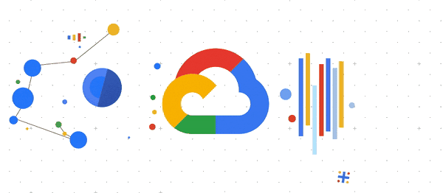

Induction Session
Google Cloud Career Practitioners Pathway
Notes:
Hey guys !!! How are you doing ??? Let's wait for another 5 mins

Slide 2

What to do in GCCP ‘22?
Learning Google Cloud with Cloud Engineering Learning Pathway
Build Projects using Google Cloud
**More details coming soon
Notes:
What to do in GCCP ‘22 ?
I hope everyone knows about the learning pathway to be completed. If not I'll be dropping the link to the learning pathway in chat box.
On december 10 your progress will be checked. If you have completed the course by then, You will be eligible to build a project with us.

Slide 3
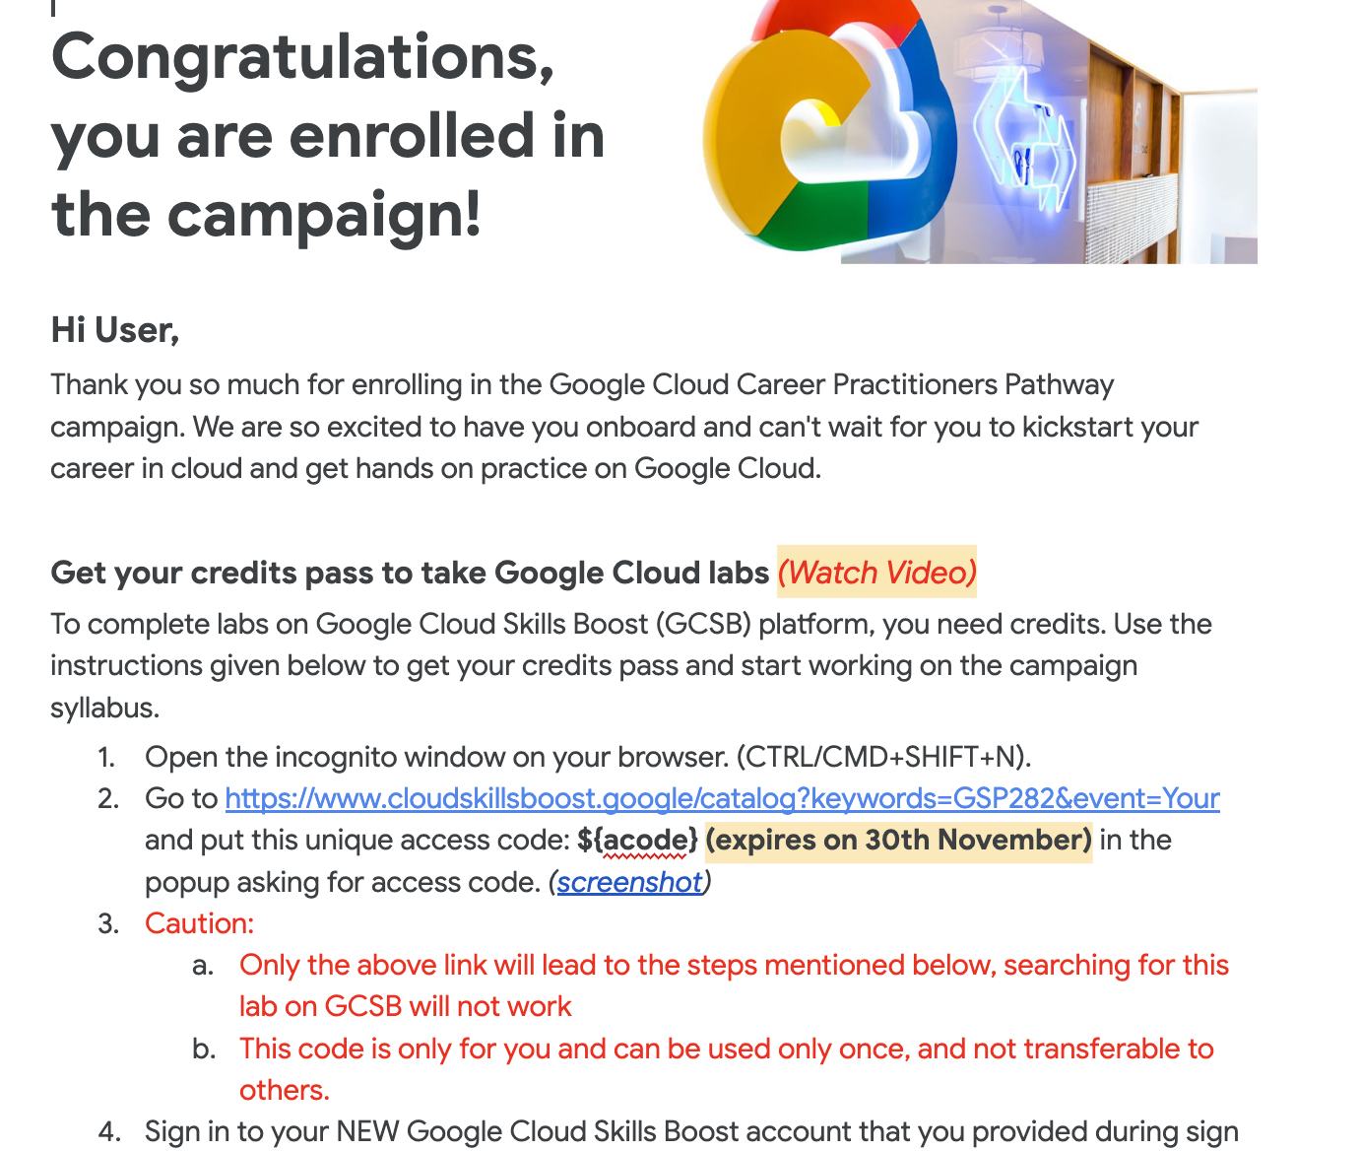
Get started..
All participants will receive an email with access code on Nov 14th
Follow the exact guidelines as mentioned in the email.
Watch this video which has all the steps explaining the process of redeeming the code
Note:
Code is Valid till : Nov 30th ONLY
Notes:
I hope everyone has redeemed their code and has access to a monthly subscription by now. If you have any problems regarding the credits. we will help you out at the end of the meeting.

Slide 4
What happens when someone doesn't see the email to access the code :
Categorised as :
Entry rejected
They're referring wrong account
Email went to spam folder
Notes:
What if you have not received the mail from Google cloud Education yet?

Slide 5
Timelines
Participants learn the course
Participants receive Access Code
Last date to Complete the course
01
Nov 14
Nov 14 - Dec 14
Dec 14th
Dec 12 -28
Weekly trainings and AMA
Facilitators Host sessions in the Campus
Project Building and Final submission
Notes:
Ok so this is the timeline we will be following

Slide 6
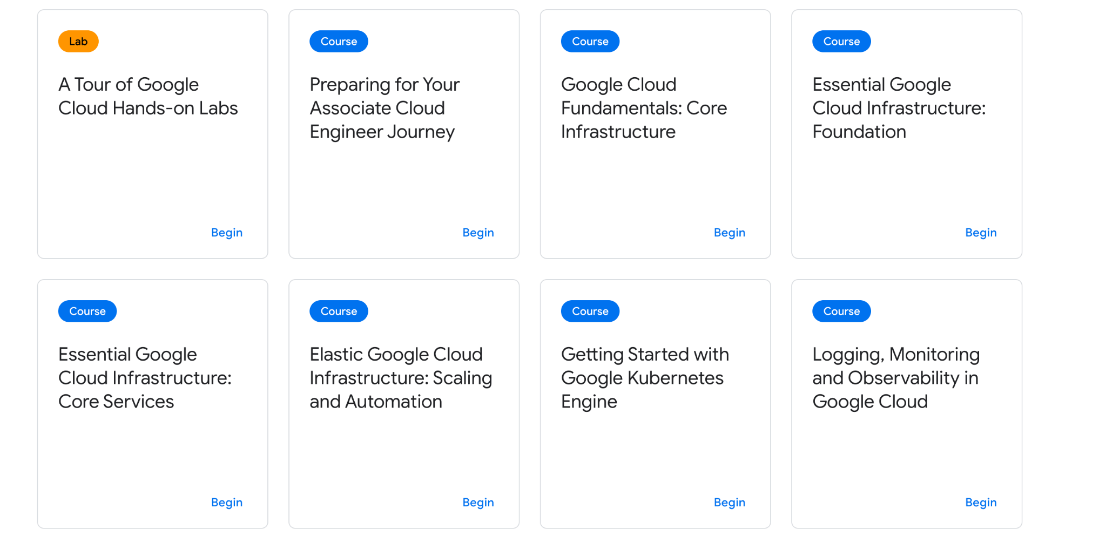
Notes:
The path which we shared has 2 parts. Course and quests. Courses contain videos and tutorials. and the quests have hands-on labs.
For course, you have full flexibility you can complete it whenever you want but it should be completed before December 10

Slide 7
A Tour of Qwiklabs and Google Cloud
Creating a VM
Using Cloud shell and gcloud
Kubernetes engine
Http load balancer
Challenge lab !!!
Week 01 - Tasks
Getting Started: Create and Manage Cloud Resources (6 labs)
Notes:
But when it comes to labs, you should complete at least 1 quest each week. You can even complete all 4 quests in 2 days that won't be a problem but you should complete one quest each week.
And for this week, you have to complete Getting started:..... Quest. The link for the same is sent in whatsapp grp yday.

Slide 8
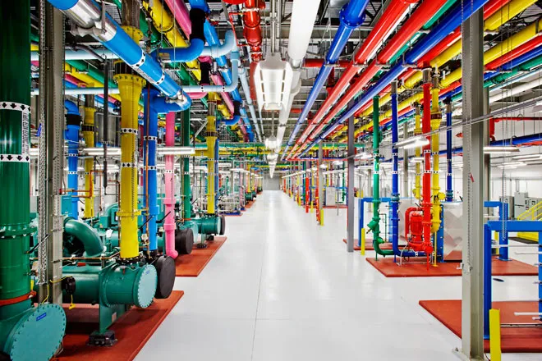
What is the cloud and cloud computing?
The “cloud" refers to servers that are accessed over the Internet, and the software and databases that run on those servers.
Cloud servers are located in data centers all over the world.
By using cloud computing, users and companies do not have to manage physical servers themselves or run software applications on their own machines.
Notes:
So, before we start with labs I’ll give a small insight into what cloud is ?
Google Drive is a perfect example for cloud. Where will the photos or files you upload on drive will be stored? They are stored in the physical servers present at the google’s data center. The next term which pops up is what is cloud computing?
Cloud computing is all about getting things done using someone else's computers.
So when you use Google Cloud, you're getting things done using Google's computers.
As simple as that.

Slide 9
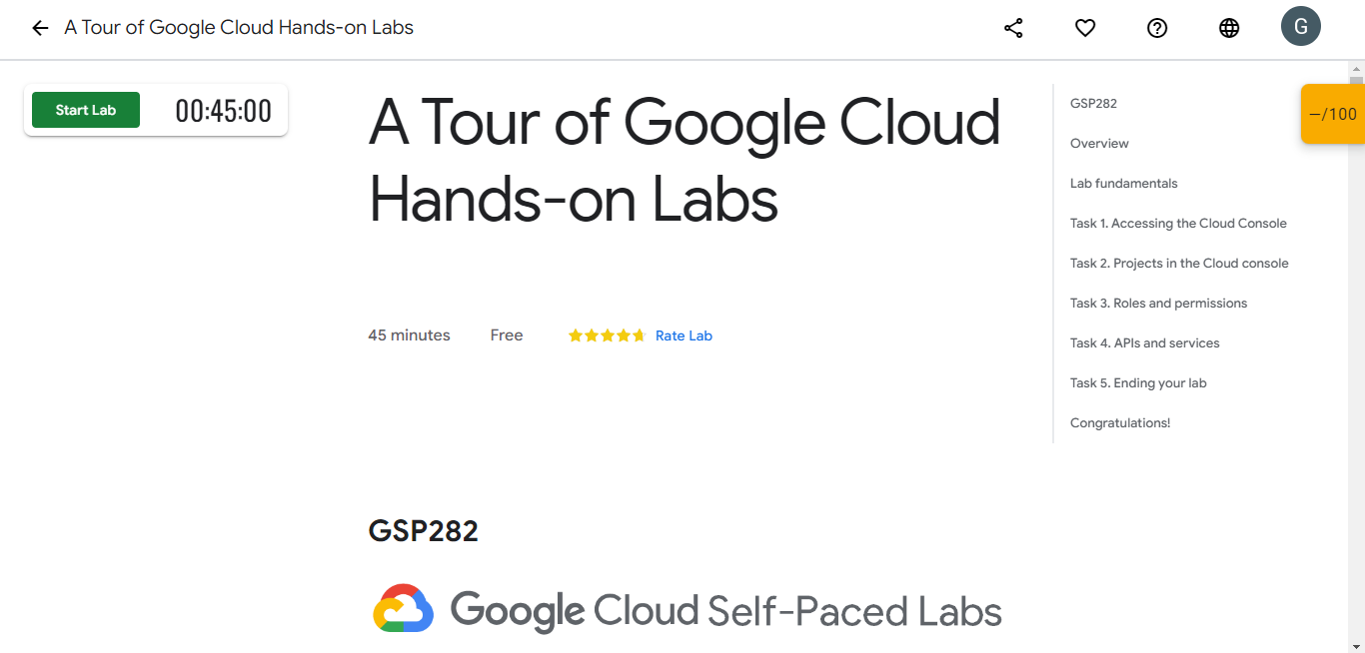
A Tour of Google Cloud Hands-on Labs
Notes:
A tour of google clouds. I hope everyone has completed this lab. So I wont take much time and jump to next lab

Slide 10
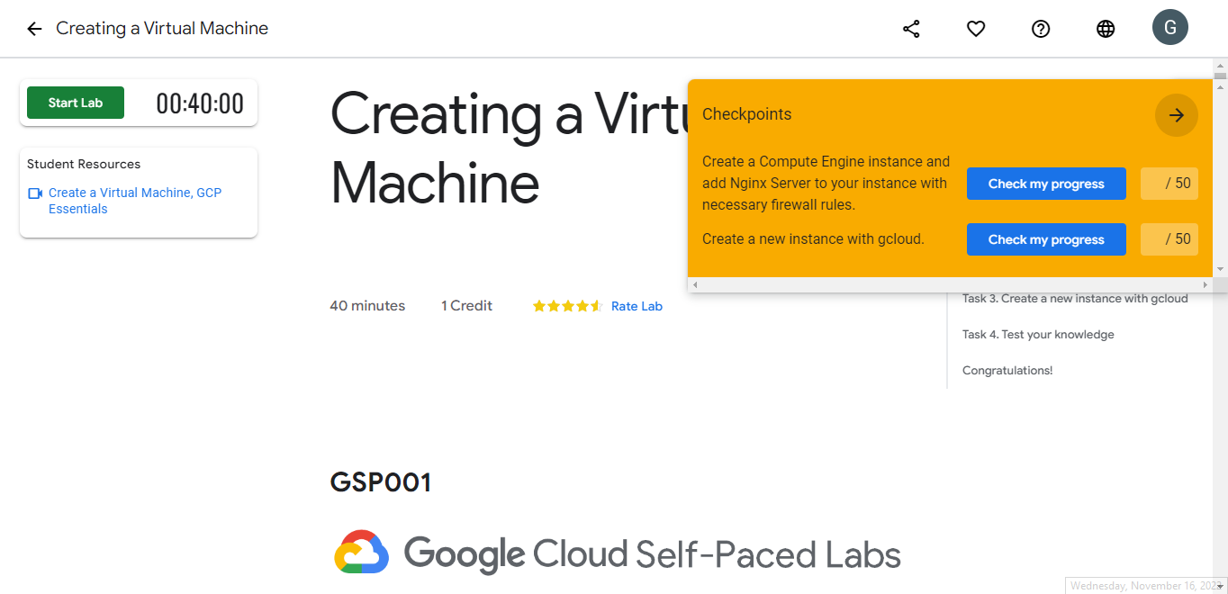
Creating a Virtual Machine
Notes:
Creating a virtual machine!!! So in this lab you will be creating a virtual machine.
Imagine a Virtual machine as a digital version of a physical computer. So by using virtual machine, you are using Google's computer. aaahh it's just an abstract about the topic you can better understand it by watching the video in the student resource you can find it below the start lab button. Virtual machines can be created using the GUI and command line aswell. in this lab, you will create a virtual machine using both GUI and command line. the instructions are provided in the labs.

Slide 11
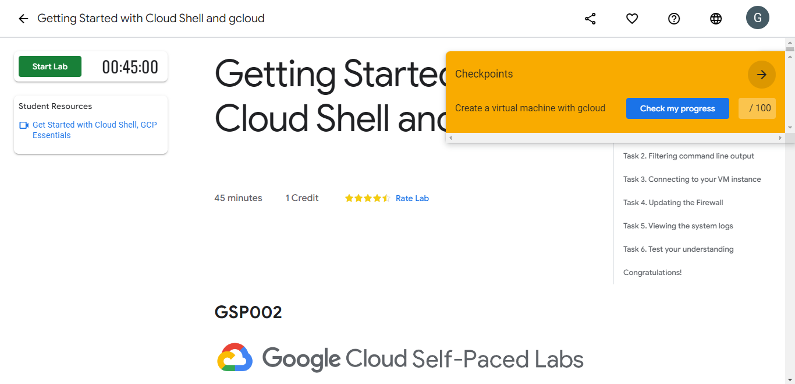
Using Cloud Shell and gcloud
Notes:
In this lab again we will be creating a virtual machine using the command line similar to the previous lab but here we will be using the command line.

Slide 12
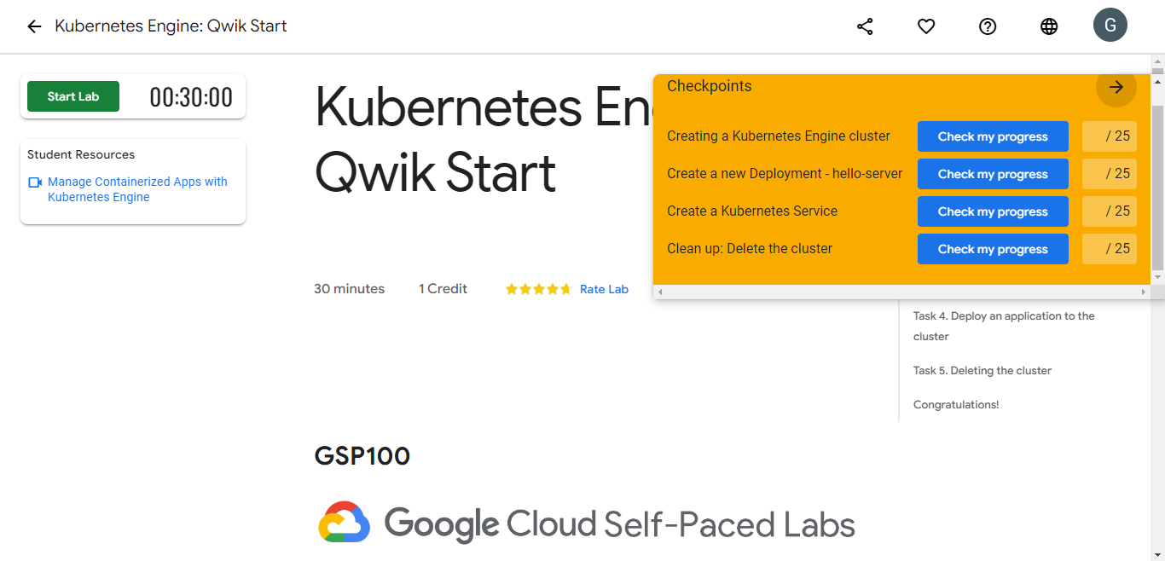
Kubernetes Engine: Qwik Start
Notes:
Next we have Kubernetes, and you have 4 checkpoints to complete the lab

Slide 13
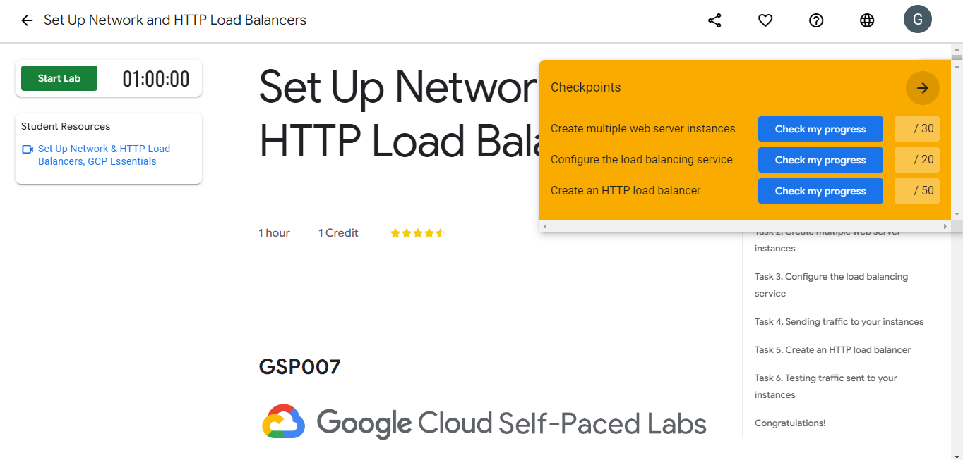
Set Up Network and HTTP Load Balancers
Notes:
At last we have load balancers lab and it has 3 checkpoints.

Slide 14
Challenge Lab !!!
Notes:
Challenge labs will not have any instructions. It'll just have a problem statement. Based on the knowledge you gained using previous labs you can solve these easily. After solving these you will get Skill badges

Slide 15
Jam session anyone?
Notes:
We thought of having JAM sessions. Where all the participants come to a lab and we'll solve the quests together. But we were uncertain about the people attending. Because labs will be free after 4 and we were not sure if people would stay in clg till 4

Slide 16
How can I track my progress?
Notes:
We will be sending you a google sheet that will have the list of quests you have completed.

Slide 17
We are happy to solve your doubts
Notes:
Every week we will be having a session like this where we will be solving your doubts. If you have any doubts, you can unmute yourself or drop it in chat box

Slide 18
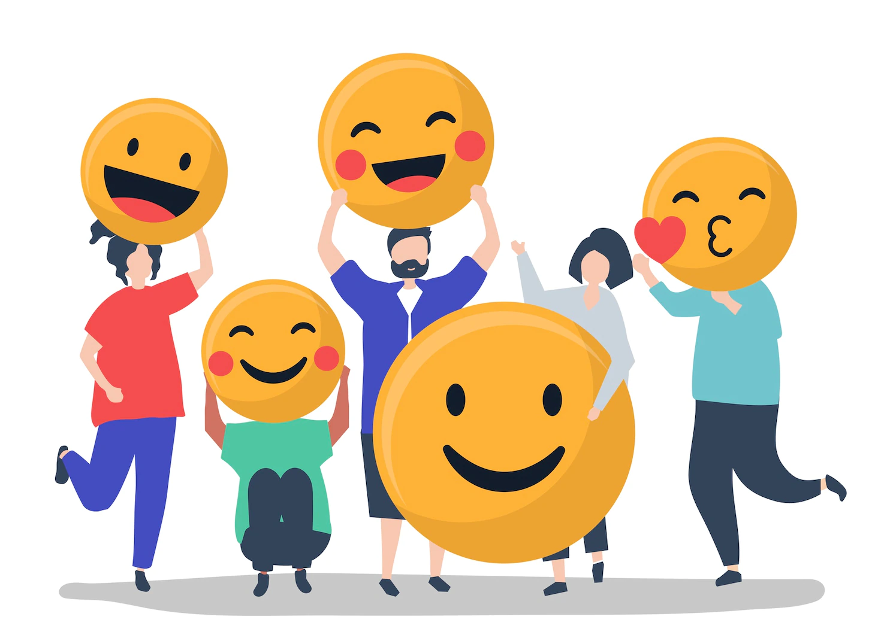
Thank you !

